Slide 1

Lecture
on
“Advanced Computer Architecture –TCS 704”
by
Akansha Gupta
DEPARTMENT OF COMPUTER SCIENCE AND ENGINEERING
GRAPHIC ERA DEEMED TO BE UNIVERSITY – 248002

Slide 2
DIRECTION IN BRANCH PREDICTION

Slide 3
Directions in Branch Prediction
1: Improve the prediction
• correlated (2-level) predictor (Pentiums)
• hybrid local/global predictor (Alpha)
2: Determine the target earlier
• branch target buffer (Pentium, Itanium)
• next address in I-cache (Alpha, UltraSPARC)
• return address stack (everybody)
3: Reduce misprediction penalty
• fetch both instruction streams (IBM mainframes)
4: Eliminate the branch
• predicated execution (Itanium)

Slide 4
1: Correlated Predictor
The rationale:
• having the prediction depend on the outcome of only 1 branch might produce bad predictions
• some branch outcomes are correlated example: same condition variable
if (d==0)
...
if (d!=0)
example: related condition variable
if (d==0)
b=1;
if (b==1)

Slide 5
1: Correlated Predictor
another example: related condition variables
if (x==2) /* branch 1 */
x=0;
if (y==2) /* branch 2 */
y=0;
if (x!=y) /* branch 3 */
do this; else do that;
• if branches 1 & 2 are taken, branch 3 is not taken ⇒ use a history of the past m branches
represents a path through the program
(but still n bits of prediction)

Slide 6
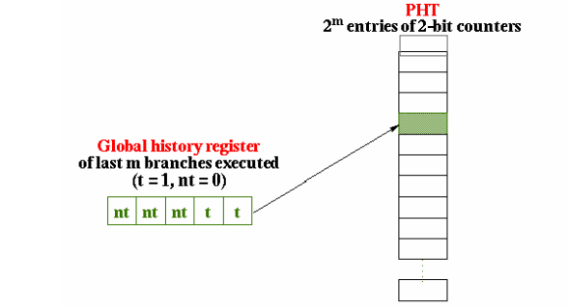
1: Correlated Predictor
General idea of correlated branch prediction:
• put the global branch history in a global history register
• global history is a shift register: shift left in the new branch outcome
• use its value to access a pattern history table (PHT) of 2-bit saturating counters

Slide 7
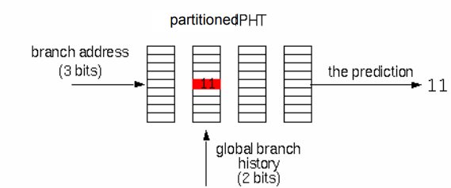
1: Correlating Predictor
Performance-intuitive organization:
Access a row in the “partitioned” PHT with the low-order bits of branch address
• Choose which PHT with the global branch history
• Contents is the prediction

Slide 8
1: Tournament Predictor
Combine branch predictors
• local, per-branch prediction, accessed by the PC
• correlated prediction based on the last m branches, assessed by the global history
• indicator of which had been the best predictor for this branch
• 2-bit counter: increase for one, decrease for the other

Slide 9
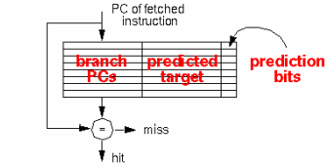
2: Branch Target Buffer (BTB)
Cache that stores: the PCs of branches
the predicted target address branch prediction bits
Accessed by PC address in fetch stage
if hit: address was for this branch instruction
fetch the target instruction if prediction bits say taken
No branch delay if: branch found in BTB
prediction is correct
(assume BTB update is done in the next cycles)

Slide 10
2: Return Address Stack
The bad news:
• indirect jumps are hard to predict
• registers are accessed several stages after fetch
The good news: most indirect jumps (85%) are returns from function
• optimize for this common case
Return address stack
• provides the return target early
• return address pushed on a call, popped on a return
• best for procedures that are called from multiple call sites
• BTB would predict address of the return from the last call
• if “big enough”, can predict returns perfectly
• these days 1-32 entries

Slide 11
3: Fetch Both Targets
Fetch target & fall-through code
• reduces the misprediction penalty
• but requires lots of I-cache bandwidth
• a dual-ported instruction cache
• requires independent bank accessing
• wide cache-to-pipeline buses

Slide 12
4: Predicated Execution
Predicated instructions execute conditionally
• some other (previous) instruction sets a condition
• predicated instruction tests the condition & executes if the condition is true
• if the condition is false, predicated instruction isn’t executed
• i.e., instruction execution is predicated on the condition
Eliminates conditional branch (expensive if mispredicted)
• changes a control hazard to a data hazard
Fetch both true & false paths

Slide 13
https://youtu.be/GMLTiwPvXcY
THANKS

